Slide 1

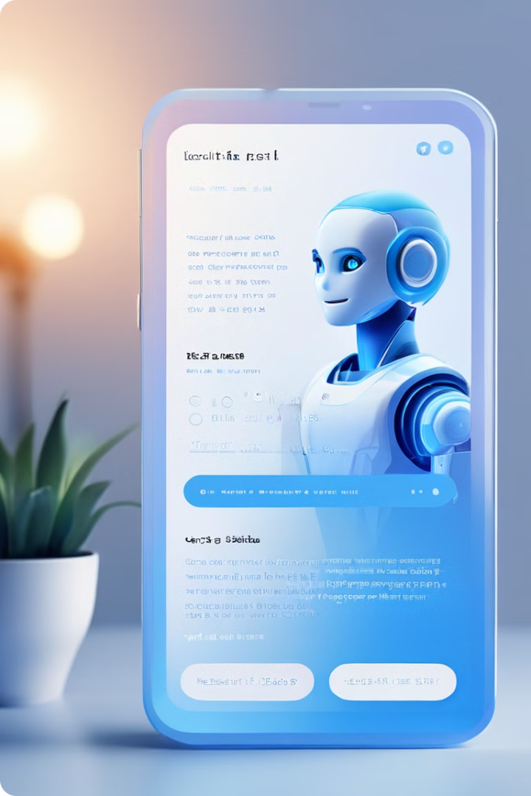
Dexter: Transforming PDF Interactions with AI-Powered Chatbot
Dexter is an advanced AI-powered chatbot that enhances the way users interact with PDF documents. Leveraging cutting-edge language models and natural language processing, Dexter enables seamless querying, information extraction, and voice-based interactions with PDF content.

Slide 2
Unleashing the Power of Dexter
Conversational AI
Multimodal Interactions
Semantic Search
Dexter utilizes Langchain to manage complex conversational workflows, allowing users to engage in natural dialogues and receive tailored responses based on the PDF content.
Dexter integrates speech recognition and text-to-speech capabilities, enabling users to query and receive information through both text and voice interfaces.
Dexter's vector store, powered by FAISS and Google Gemini Pro embeddings, enables advanced semantic search, allowing users to find relevant information across PDF documents.

Slide 3

Setting Up the Dexter Environment
1
Python Dependencies
Dexter requires Python and a set of libraries, including Langchain, Streamlit, PyPDF2, FAISS, and Langchain-Google-GenAI.
2
Obtaining API Keys
Users need to obtain API keys from Google Gemini Pro to leverage the powerful natural language processing capabilities.
3
Environment Variables
Dexter utilizes Python-Dotenv to securely manage API keys and other sensitive configuration settings.
4
Installation Guide
Clear step-by-step instructions are provided to ensure a seamless setup process for Dexter.

Slide 4
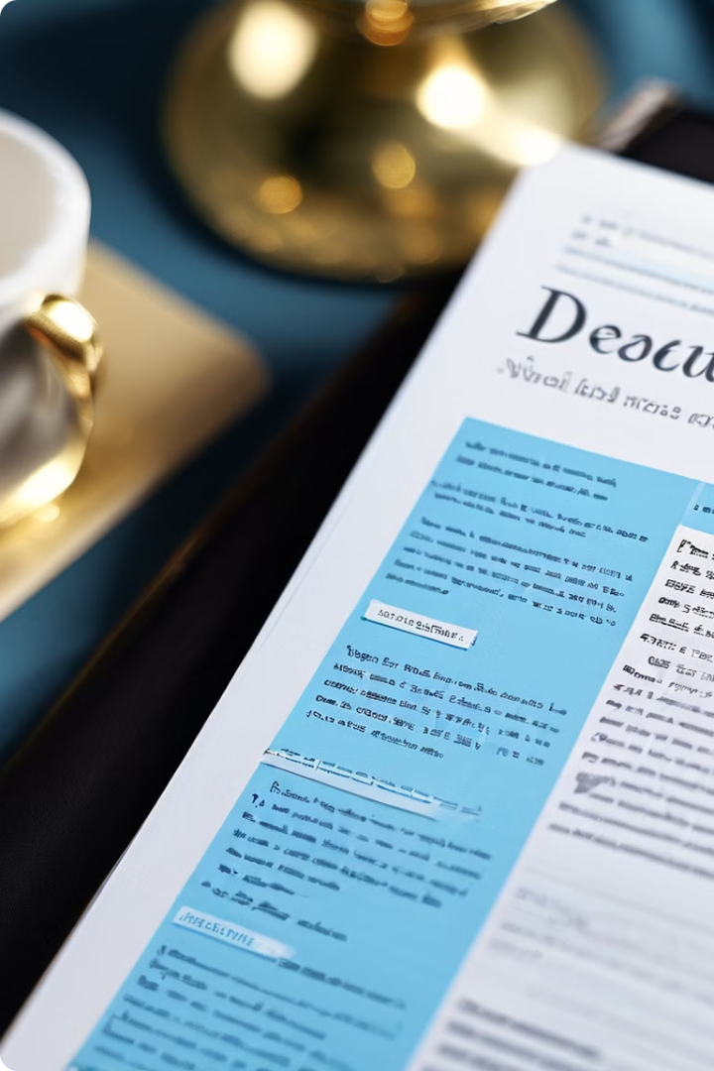
Preparing PDF Documents for Dexter
1
PDF Ingestion
Dexter leverages PyPDF2 to extract text from PDF documents, allowing users to upload and process their PDF content.
2
Text Chunking
Langchain's RecursiveCharacterTextSplitter is used to break down the extracted text into manageable chunks, enabling efficient processing and retrieval.
3
Semantic Embeddings
Dexter creates vector embeddings for each text chunk using Google Generative AI's pre-trained models, powering the semantic search capabilities.

Slide 5
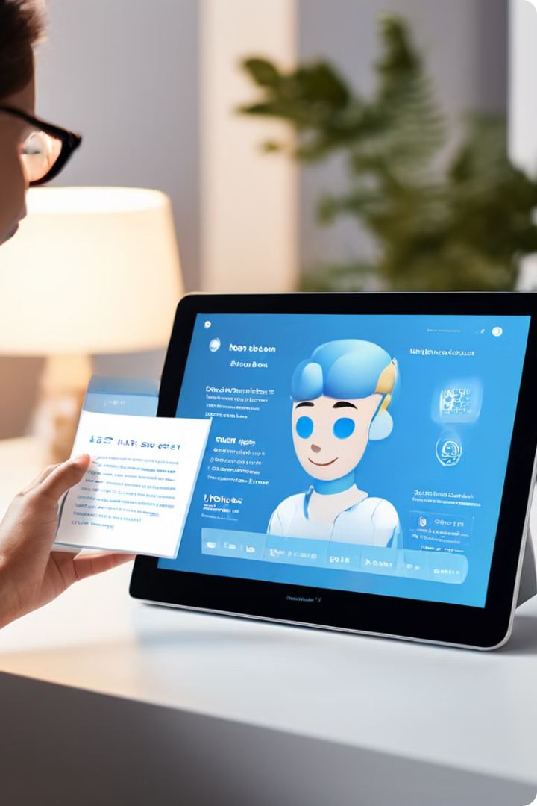



Conversational Experience with Dexter
User Query
Users can submit their questions either through text or voice, leveraging Dexter's multimodal input capabilities.
Semantic Search
Dexter's FAISS-powered vector store is queried to find the most relevant text chunks based on the user's input.
Response Generation
Dexter utilizes Langchain's QA chain and Google Gemini Pro's language model to generate detailed and contextual responses.

Slide 6




Dexter's Audio Superpowers
Speech Input
Dexter seamlessly integrates speech recognition capabilities, allowing users to issue voice commands and queries.
Audible Responses
Dexter's text-to-speech engine generates natural-sounding audio responses, providing an engaging and accessible experience.
Customizable Settings
End User can adjust the volume and speech rate to suit their preferences, ensuring a personalized interaction with Dexter.

Slide 7
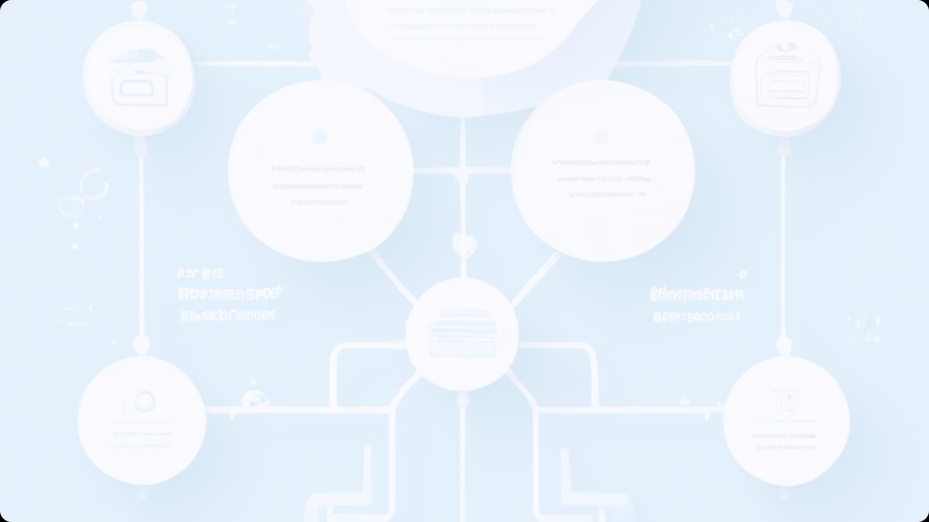
Dexter's Workflow Visualization
PDF Ingestion
Text Extraction
Text Chunking
Embeddings Generation
Vector Store Creation
Semantic Search
Language Model Inference
Response Generation

Slide 8
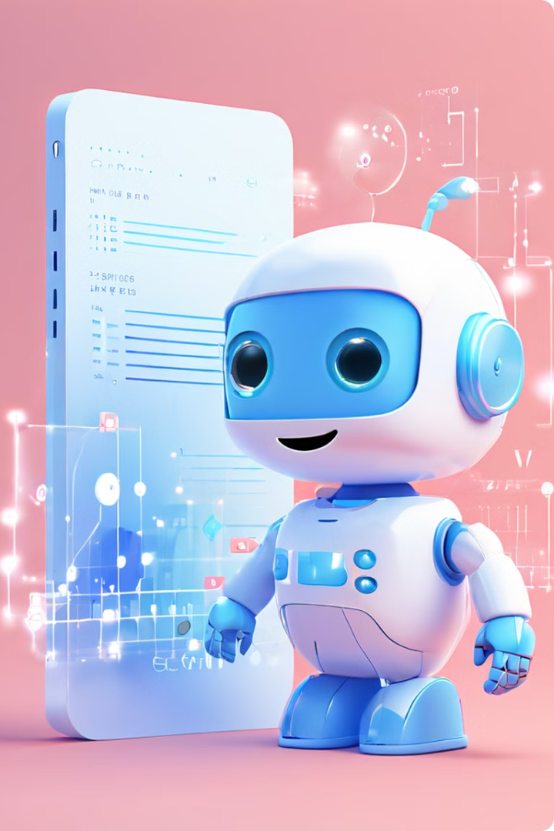
Dexter: The Future of PDF Interaction
Intelligent Querying
Dexter's conversational AI enables users to ask complex questions and receive contextual answers from PDF content.
Multimodal Experiences
Seamless integration of text and voice interfaces for a more intuitive and accessible user experience.
Scalable Solution
Dexter's modular architecture and advanced AI capabilities make it a scalable solution for organizations of all sizes.
Continuous Innovation
Dexter leverages the latest advancements in natural language processing and generative AI to provide cutting-edge functionality.

